Slide 1

KLH UNIVERSITY
Hyderabad – Bachupally Campus
Department of Electronics and Communication Engineering
Conservative Offline Deep Reinforcement Learning
for Safe Spectrum Access in Dense IoT Networks
PROJECT PROGRESS PRESENTATION
PROJECT GUIDE
Dr. Vinnakota Venu Balaji
PROJECT TEAM
Mithilesh Gullapalli
Roll No.: 2520040056
Tejashwer Reddy S
Roll No.: 2520040059
Paidi Sai Chaitanya
Roll No.: 2520049125
Electronics and Communication Engineering • KLH University

Slide 2
1. Problem Statement
• Dense IoT networks have many devices competing for limited wireless spectrum.
• Channel congestion and interference can increase packet loss, latency and energy cost.
• A live trial-and-error RL agent may explore unsafe spectrum actions.
• The project studies offline learning: use historical transmission data to learn a channel-selection policy.
• Safety is treated explicitly through interference, collision, packet-loss and latency constraints.
Core decision
Which channel?
given the current network state
Objective
High reward
performance − risk/cost
Constraint
Safe access
avoid high-risk channel choices
KLH University • Bachupally Campus • Department of Electronics & Communication Engineering
2
2

Slide 3
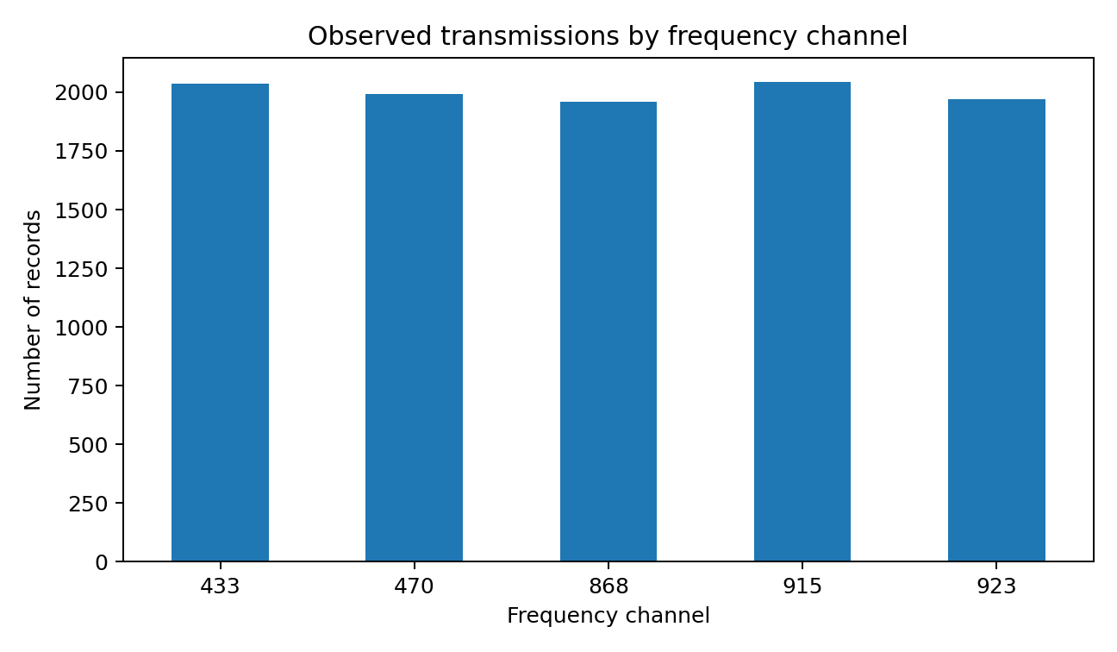
2. Dataset and Feature Selection
Records
10,000
uploaded transmission dataset
Features
42
raw dataset columns
Channels
5
433, 470, 868, 915, 923
Missing cells
0
before selected-feature cleaning
• State: Channel_Occupancy, Interference_Power, Interference_Density, Packet_Collision_Rate, Packet_Loss_Rate.
• State: Latency, RSSI, SNR, Node_Density and Network_Congestion.
• Action: Frequency_Channel.
• Reward: combines data rate and delivery success, with penalties for interference, packet loss, latency and energy cost.
• The dataset is observational; the project therefore reports offline/empirical evaluation rather than live-network causal performance.
KLH University • Bachupally Campus • Department of Electronics & Communication Engineering
3
3

Slide 4
3. Proposed Methodology
1. State
10 network features
2. Action
Select one frequency
3. Reward
Performance − risk
4. Offline Q-learning
Learn from recorded data
5. Conservative term
Penalize unsupported optimism
6. Safety filter
Reject high-risk actions
• Q-network output: one Q-value per available channel.
• Policy chooses the highest-valued action that passes the historical safety filter.
• Implementation is a CQL-style one-step offline Q-learning prototype for the progress stage.
KLH University • Bachupally Campus • Department of Electronics & Communication Engineering
4
4

Slide 5
4. Project Workflow / Implementation
Transmission
Dataset
Preprocess &
Normalize
State–Action–
Reward
Conservative
Q Network
Safety
Filter
Evaluation &
Plots
• Environment is represented through recorded transmission states rather than live RF experimentation.
• Training uses only the offline dataset; test records remain held out for evaluation.
• Outputs include channel decisions, reward, risk and safety status.
KLH University • Bachupally Campus • Department of Electronics & Communication Engineering
5
5

Slide 6
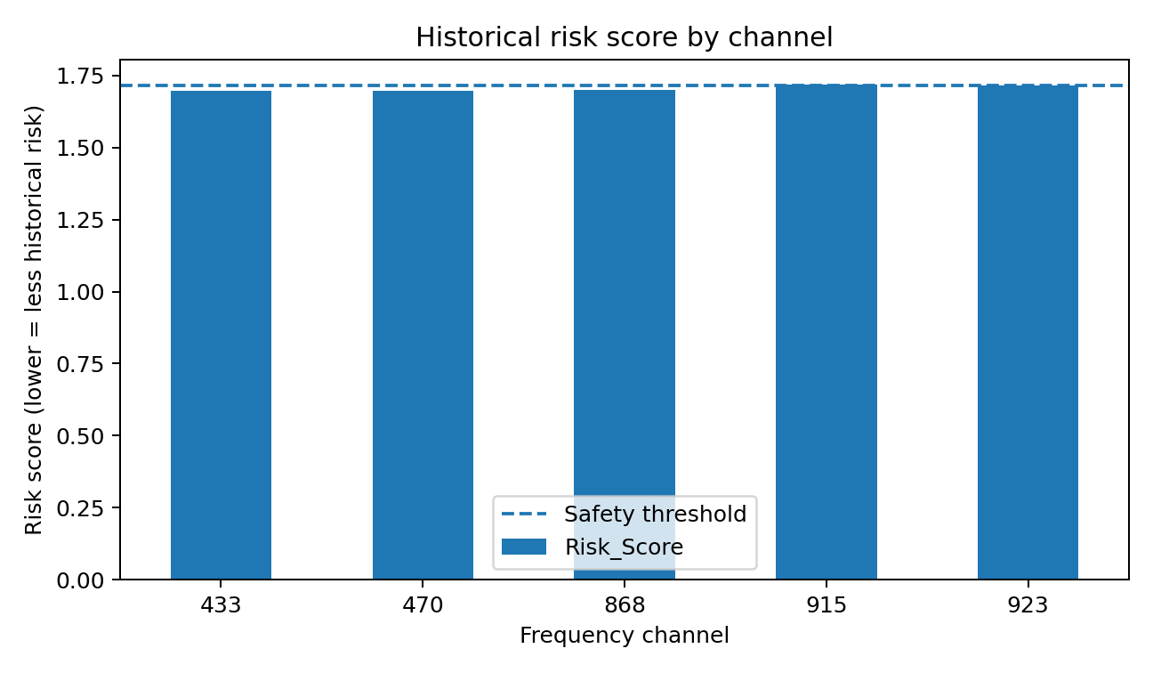
5. Preliminary Experimental Results — Dataset Analysis
Computed directly from the uploaded dataset
• Observed channels: 433, 470, 868, 915, 923.
• Lowest historical mean risk channel in this analysis: 470 (risk score 1.697).
• Highest mean reward channel in the empirical analysis: 923 (reward 0.219).
• Risk score is a project-defined normalized screening metric, not a standardized RF safety metric.
KLH University • Bachupally Campus • Department of Electronics & Communication Engineering
6
6

Slide 7
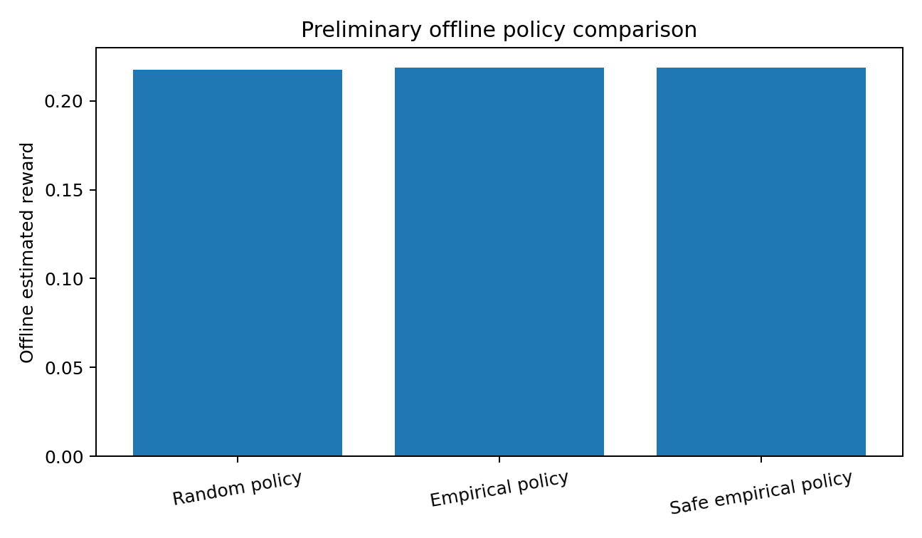
6. Preliminary Offline Policy Results
One-step empirical offline evaluation; values are estimated from historical channel rewards
Random policy
0.2176
estimated mean reward
Empirical policy
0.2175
channel 923
Safe empirical policy
0.2181
channel 923
• These results establish a baseline for the offline decision problem.
• They are not live-network measurements and do not establish causal improvement.
• The next validation step is to compare the trained conservative Q policy against these baselines on the held-out test set.
KLH University • Bachupally Campus • Department of Electronics & Communication Engineering
7
7

Slide 8
7. Current Progress and Remaining Work
COMPLETED
REMAINING
• Dataset loaded and inspected
• Relevant state features selected
• Frequency channels mapped to discrete actions
• Reward function defined
• Offline baseline evaluation completed
• Safety risk score and historical screening implemented
• Run full conservative Q-network training on the cleaned dataset
• Evaluate the learned policy on held-out records
• Add ablation/sensitivity analysis for the conservative coefficient
• Generate final throughput, packet-loss, latency and safety-violation plots
• Package source code, dataset description and run instructions in GitHub
KLH University • Bachupally Campus • Department of Electronics & Communication Engineering
8
8

Slide 9
8. Project Repository and Next Deliverables
• GitHub repository structure:
• • README.md — problem, methodology, setup and results
• • data/ — dataset details and source information (do not commit restricted/raw data if licensing prohibits it)
• • src/ — preprocessing, reward, model, safety filter and evaluation code
• • results/ — figures and metric tables
• • requirements.txt — Python dependencies
• • presentation/ — progress PPT
• Current evidence: 10,000-record transmission dataset successfully mapped to the spectrum-access problem.
• The project now has a defined state, action, reward and safety formulation.
• Next milestone: complete held-out conservative-policy evaluation and finalize the reproducible GitHub package.
Presentation focus
Progress + measurable evidence
No abstract; 8 slides total
KLH University • Bachupally Campus • Department of Electronics & Communication Engineering
9
9

